Slide 1

Airport Data Analysis
Created By
Satyam Patel & Karishma Grover

Slide 2
Problem Statement
Learn to develop Airport and Airline data analysis dashboard development. Prepare a project to identify where the various flights are going and what will be the busiest and most lengthy routes from the airport. Also, create a hidden filter within the dashboard.
Find key metrics and factors and show the meaningful relationships between attributes.
Do your own research and come up with your findings.

Slide 3
Approach
Understanding Problem Statement
Collecting and understanding the data
Data Cleaning, Data Transformation, Data Modeling
Data Visualization using Power Bi

Slide 4
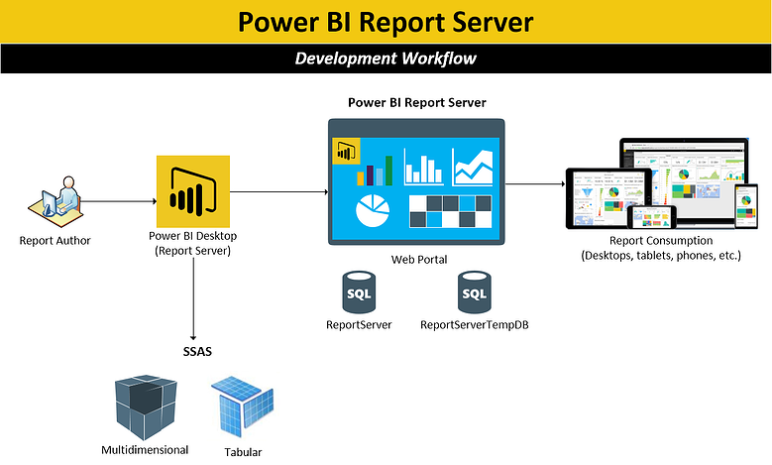

Slide 5
Why do We Do Airport Data Analysis?
Airport data analytics are considered the enabler to unleash key information and knowledge that will help to address many of the key areas where airports face challenges. These areas extend to almost every facet of airport processes, from purely operational ones – such as airport resource usage optimization, maintenance, and airport capacity – to non–aeronautical revenue intensification and passenger experience maximization.

Slide 6
Which Data We Used It
For this project, we used data from the San Francisco Airport for March 2020. To proceed we have taken the important aspects like Coordinates, Route, Date, Base Airline, Terminal (Gate No.), Actual time, and Estimated time. In order to get data for the Airport and Airlines we have added the dataset for Airport information (City, IATA, Country, Name, Code). Using this information, we have figured most common destinations that were frequent from San Francisco, the busiest route covered along with the distance covered during those flights.

Slide 7
Step Followed :
Collecting the data from the sources.
Performing the Data cleaning with the help of a power Query in which we removed irrelevant columns such as Geometry Type, Properties Edtf Cessation, Properties Edtf Inception, and Properties Flysfo Base Flight Number.
Splitting the route column by delimiter into two columns named to_city and from_city.
Performing conditional replacement in Properties Flysfo Base Airline.
Converting Properties Flysfo Estimated Timestamp and Properties Flysfo Actual Timestamp to Estimated date time and Actual Date Time Columns with the help of M language.
Created diff columns by subtracting actual date time from estimated date time.
Created a Conditional Column for terminals and Flight Status.

Slide 8
Continue…
Connected the Clean data in the Power bi.
After the connection created the date column using the time intelligence function of DAX
Connected the Clean data in the Power bi.
After the connection created the date column using the time intelligence function of DAX.
Prepare a model connection in power bi in model view.

Slide 9
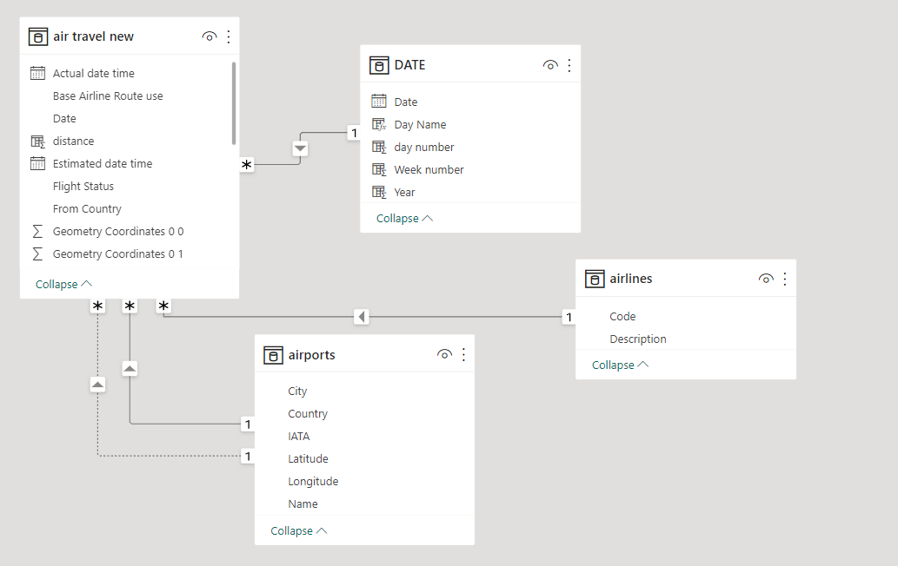
Continue…

Slide 10
Continue…
Created Calculated Column for Distance by using DAX
Created measures like average delay, flight going, the total flight landed, the total flight takes off and etc.
Try to solve the problem statement by using different visuals in power bi.

Slide 11
Insights
﻿﻿ Los Angeles was the most frequent destination from San Francisco airport with a Count of 3,932, followed by New York and Seattle.﻿﻿
﻿﻿ Los Angeles accounted for 8.63% of the flights Taken off from San Francisco
﻿﻿ Across all 30 Countries ﻿﻿﻿at 19,237.11, United Arab Emirates had the highest Max of distance and was 420.04% higher than El Salvador, which had the lowest Max of distance at 3,699.16.﻿﻿
﻿﻿﻿﻿﻿ United Air Lines Inc. had the highest used Base Airline Route which was 55,463.33% higher than EgyptAir, which had the lowest Count of Base Airline Route used by 30 Countries.﻿﻿
﻿﻿ United Air Lines Inc. accounted for 18.83% of the Count of Base Airline routes used.

Slide 12
Continue…
The Count of Reschedule Flights was 44,116, followed by On-time at 30,129 and Delay at 14,276.﻿﻿
Reschedule accounted for 49.84% of the Count of Flight Status.﻿﻿
﻿ ﻿Terminal 3 was the busiest terminal at 35,727, followed by Terminal 2, International Terminal, and Terminal 1.﻿﻿
Terminal 3 was accountable for 46.92% of the Count of Terminal.﻿﻿
﻿Count of Landed flights was 45,573 which was higher than take-off flights that are 42,948.

Slide 13
Thank you

